Slide 1
Active and Available Inventory (AAI)
Notes:
1

Slide 2
Agenda
Introduction
Architecture
External Interaction & APIs
Model Overview
Core Component Insights
Schema mS: Create/Manage a new Schema
Resource mS: CRUD operations to operate on a given schema
Others: Babel, Model Loader, Data Storage, Traversal
Installation & Demo

Slide 3
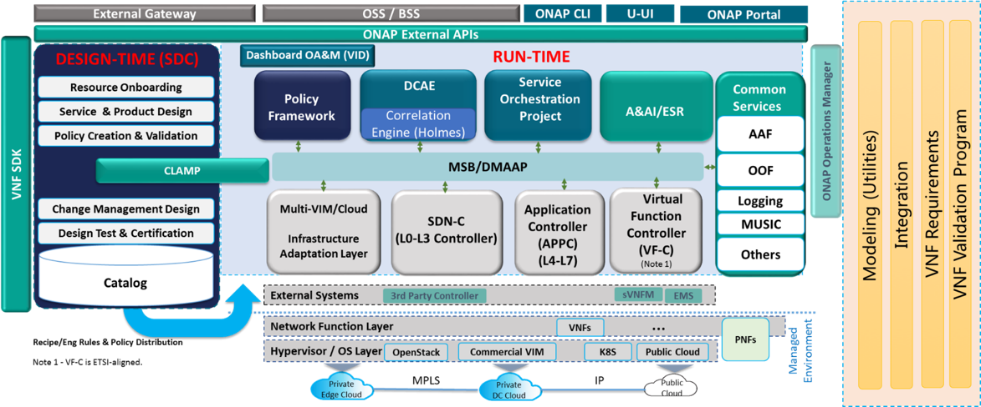
https://docs.onap.org/projects/onap-aai-aai-common/en/istanbul/platform/architecture.html
AAI Overview
Active and Available Inventory (AAI) is centralized Registry of the active, available, and assigned assets in ONAP. It provide real-time management & views of the resources, services, and their relationships via dynamic schema-driven APIs. Data in AAI is continually updated in real-time.
AAI is based on model/schema driven architecture approach for inventory subsystem, which means AAI API & graph schema are driven by its Data Model without need of any new coding. AAI uses a Graph Database based on JanusGraph.

Slide 4

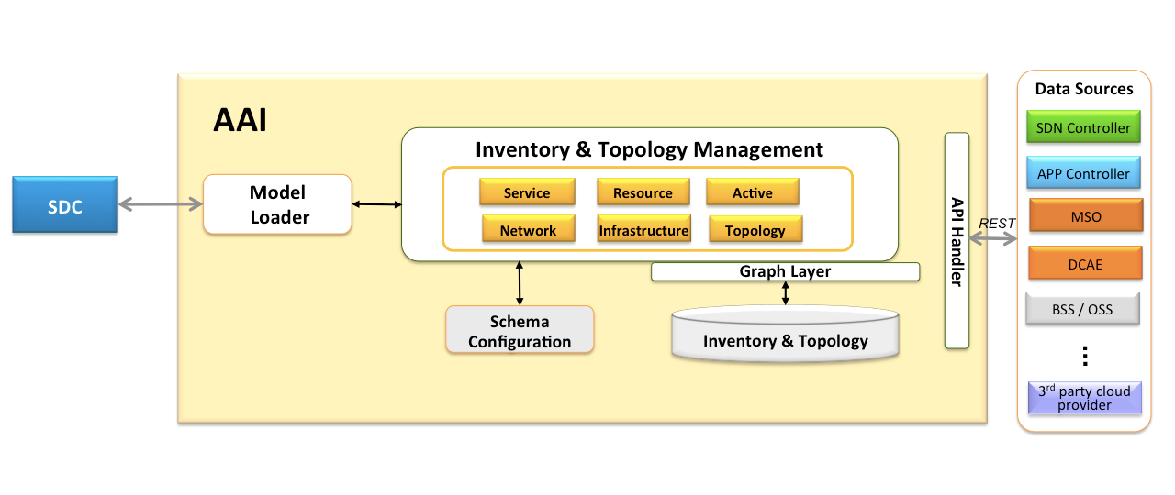
https://docs.onap.org/projects/onap-aai-aai-common/en/istanbul/platform/architecture.html
AAI Overview: Design to Runtime
Phase I: AAI Schema Design & Update
AAI schemas are represented in OXM (Object XML mapping) file along with EdgeRule JSON file
AAI is recompiled with OXM file to update schema and generate required APIs.
Additionally XSD based schema is generated from OXM, this XSD file is used by AAI Client library (for usage by other ONAP components).
Phase II: ONAP Service Design
The Model Loader polls the topic for new TOSCA CSAR distributions. It GETs the new CSAR.
Model Loader facilitates the distribution and ingestion of new service and resource information from SDC to AAI
Phase III: ONAP Runtime
Using AAI client/ direct REST APIs other ONAP components interact with AAI.
AAI operates on JANUS Graph DB using Gremlin Query language
OXM Files

Slide 5
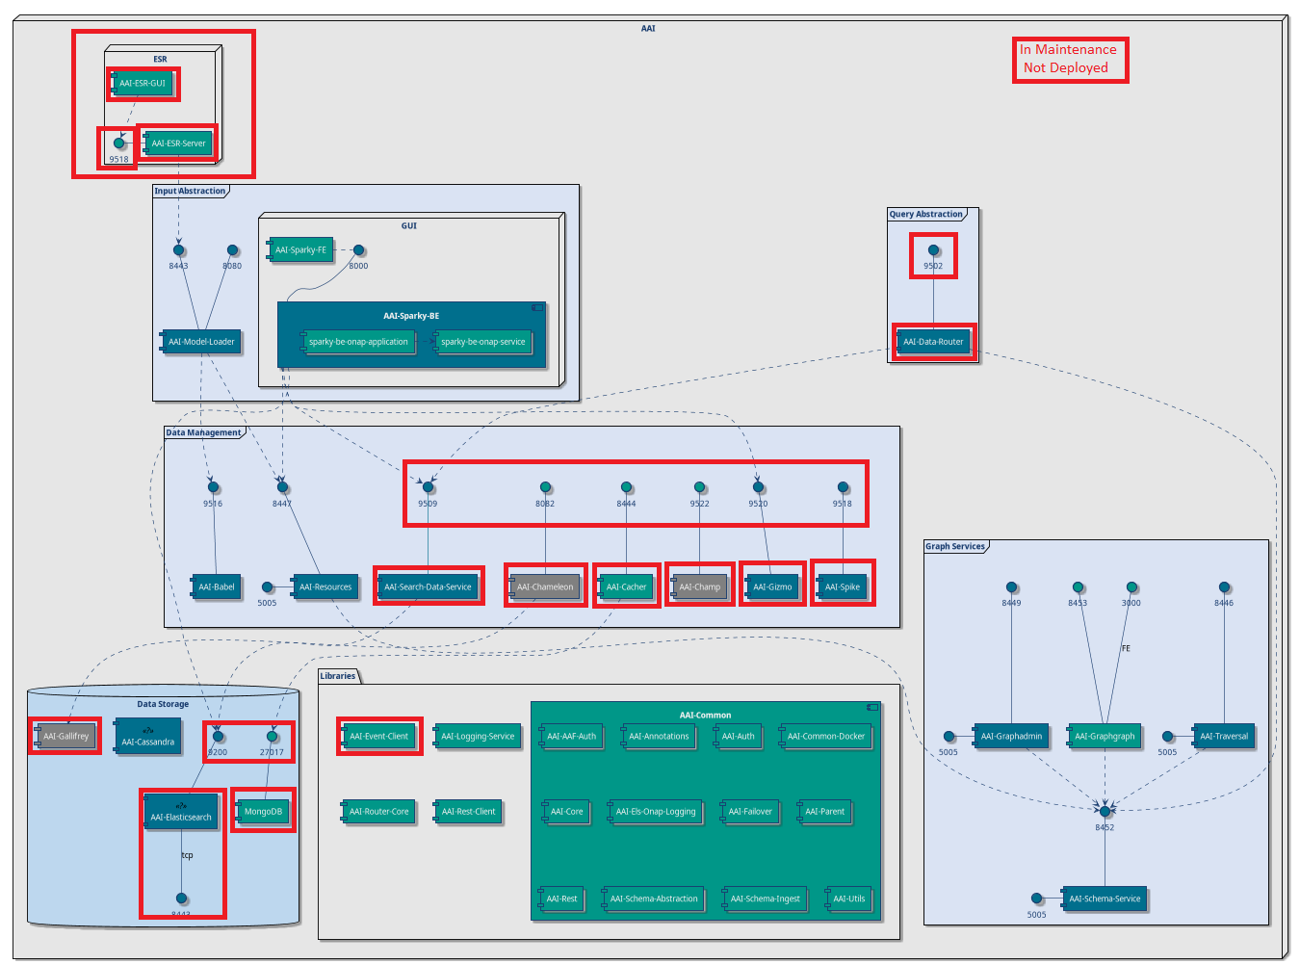
https://docs.onap.org/projects/onap-aai-aai-common/en/istanbul/platform/architecture.html
AAI Architecture: Components
ESR: Applications for management of external systems.
ESR GUI
aai/esr-gui | External system management ui.
aai/esr-server | ESR backend, mainly include the function of external system reachable check and data pretreatment.
ESR BE
Input abstraction:Applications that serve as entry points to A&AI.
Sparky FE
aai/model-loader | Obtains SDC artifacts and loads them into the A&AI Resources service for storage.
aai/sparky-be | AAI user interface back end.
aai/sparky-fe | AAI user interface front end.
Sparky BE
Data Router
Query abstraction:Query abstraction point for clients that routes AAI queries and event data.
aai/data-router | Makes decisions about workloads to be dispatched to search and tabular microservces. Includes logic to recognize and direct requests based on request archetypes
Graph service:Set of components, which store, provide or display schemas.
aai/graphadmin | Microservice with various functions for graph management.
aai/graphgraph | Microservice used to provide view of AAI model, schema and edge rules.
aai/schema-service | Centralized hub for all A&AI schema needs
aai/traversal | AAI Traversal Micro Service providing REST APIs for traversal/search of inventory resources.
Graphadmin
Graphgraph
Traversal
Schema service
Notes:
https://docs.onap.org/projects/onap-aai-aai-common/en/istanbul/platform/architecture.html
https://wiki.onap.org/display/DW/AAI+History+Documentation

Slide 6
https://docs.onap.org/projects/onap-aai-aai-common/en/istanbul/platform/architecture.html
AAI Architecture: Components
Data Management:Microservices that facilitate data management of AAI objects
aai/babel | AAI Microservice to generate AAI model XML from SDC TOSCA CSAR artifacts.
aai/cacher | Cacher is a generic service that can be used to snapshot json responses,.
aai/chameleon | (deprecated) Abstraction service for historical database.
aai/champ | (deprecated)Abstraction from underlying graph storage systems that A&AI would interface with.
aai/gizmo | (deprecated) CRUD Rest API endpoint for resources and relationships, delivering atomic interactions with the graph for improved scalability.
aai/resources | AAI Resources Micro Service providing CRUD REST APIs for inventory resources. This microservice provides the main path for updating and searching the graph - java-types defined in the OXM file for each version of the API define the REST endpoints - for example, the java-type “CloudRegion” in aai-common/aai-schema/src/main/resources/oxm/aai_oxm_v11.xml maps to /aai/v11/cloud-infrastructure/cloud-regions/cloud-region.
aai/search-data-service | Used by UI, for complex search by using indexing from Elasticsearch.
aai/spike | (deprecated) Microservice used to generate events describing changes to the graph data.
search data
chameleon
cacher
champ
Babbel
resource
Gizmo
Spike
Library: contains general functionality, which may be imported and used in other modules
aai/aai-common | This holds the model, annotations and common modules used across the Resources and Traversal micro services.
aai/event-client | Event bus client library.
aai/logging-service | AAI common logging library.
aai/rest-client | Library for making REST calls.
aai/router-core | Library containing the core camel components for the data router.
aai-common
event client
logging service
router core
rest client
Notes:
https://docs.onap.org/projects/onap-aai-aai-common/en/istanbul/platform/architecture.html

Slide 7
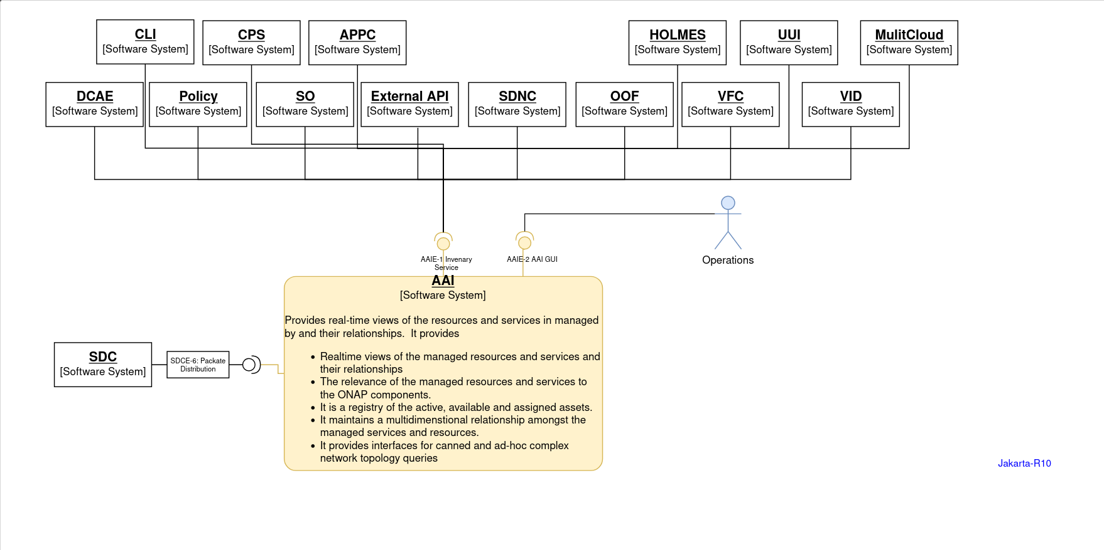
https://wiki.onap.org/display/DW/ARC+AAI+Component+Description+-+Jakarta-R10
https://docs.onap.org/en/elalto/submodules/aai/aai-common.git/docs/AAI%20REST%20API%20Documentation/AAIRESTAPI.html
AAI External Interaction & API
AAIE-1 | Inventory Service Interface. CRUD & Queries | An interface to create, update, retrieve, query, delete the service, resources and relationship inventory information for: Cloud infrastructure (including cloud infrastructure regions and availability zones, cloud infrastructure resources such as servers, storage, VLANs, cloud network technologies,...) Paths and connectors Business Customers and business customer relationship to managed assets Service Instances (including the relationship to used resources) Resource instances (including allotted resources) (virtual and physical, including VNFs, PNFs, Switches, VNF modules) External systems (systems that ONAP connects to) Images Networks Infrastructure tenants Relationships Interfaces IP addresses Configurations Licenses Site resources AAI provides multiple interfaces to use canned queries, dynamic queries (DSL), and CRUD operations (Resources)
AAIE-2 | AAI Graphical User Interfaces | Provides the capability to view the inventory

Slide 8
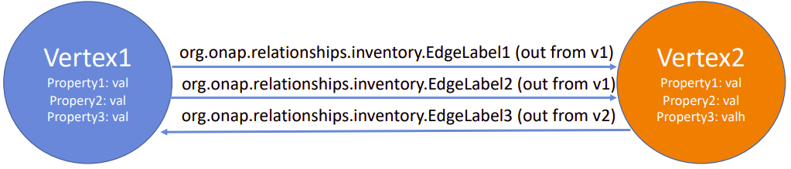
AAI Graph
https://docs.janusgraph.org/schema/
A&AI uses Janusgraph for persistence which is a property graph model, where a graph is a set of vertices with edges between them.
A vertex is the fundamental unit of the graph and represents an object. Vertex can have properties to describe the object.
An edge is a connection between two vertices that expresses a relationship between them. An edge can have a multiplicity, direction, and properties.
In Onap, for each instance of a service or resource, related informations are stored in graph DB as a vertex alongwith its properties.
Relationship between nodes is created using Edge.
For example, information and relationship between pserver and p-interfaces will be maintained as 3 vertices with 2 edges
p-interface(V2)
prop1: interface-name
prop2:: interface-name2
prop3:: selflink
prop4: speed-value
…
pserver(V1)
property1: hostname
property2: ptnii-equip-name
property3: number-of-cpus
property4: disk-in-gigabytes
….
tosca.relationships.network.BindsTo
Out from p-Interface vertex
In to pserver vertex
p-interface(V3)
prop1: interface-name
prop2:: interface-name2
prop3:: selflink
prop4: speed-value
…

Slide 9
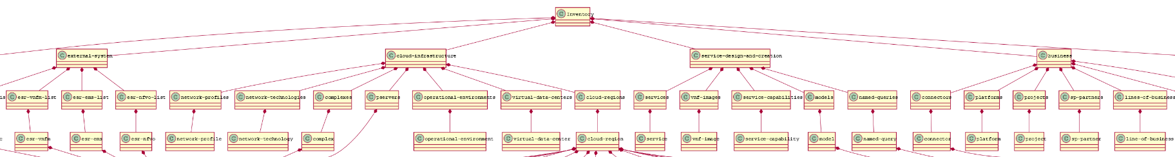
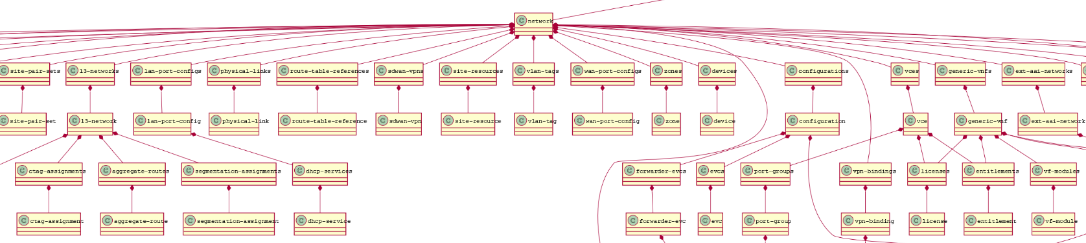
https://wiki.onap.org/display/DW/AAI+OXM+Schema+UML
https://wiki.onap.org/download/attachments/76875673/CCVPN%20network%20NNI%20AAI%20Models.pdf?version=1&modificationDate=1579781948000&api=v2&download=true
AAI Data Model
5 top level elements
Usually hierarchy goes like this: Tenant/Customer → Service Subscription → Service Instance → Resources (Refer CCVPN example)

Slide 10
Core Components Insights
Schema service, Resources Service
Traversal, Model Loader, Babel

Slide 11
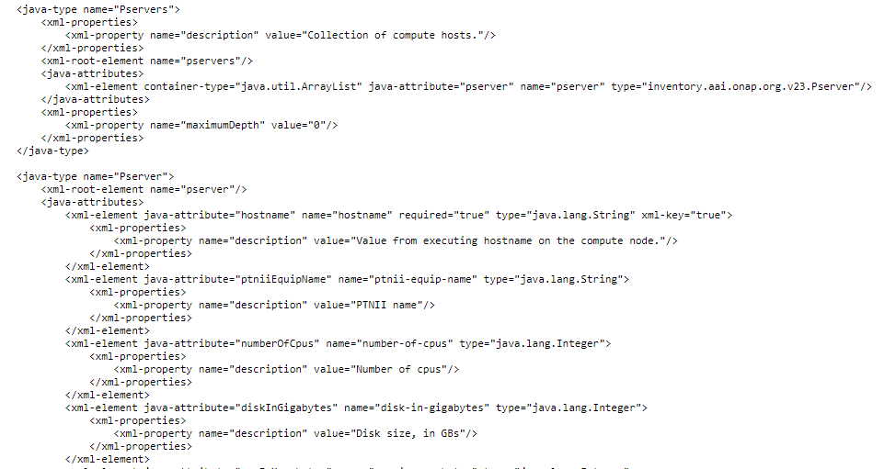
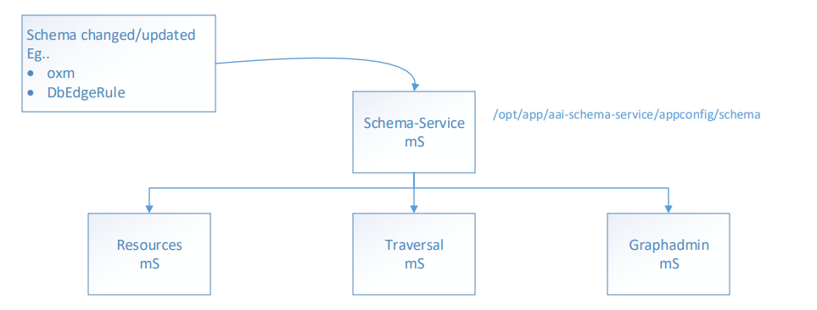
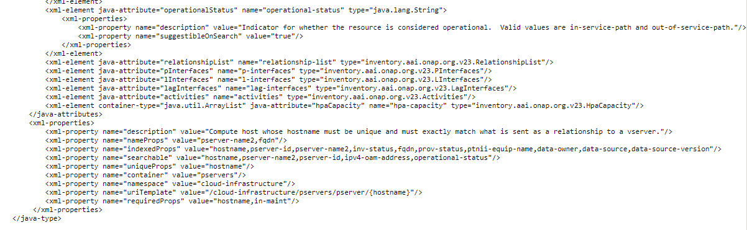
https://wiki.onap.org/pages/viewpage.action?pageId=45295931
Core Components: Schema
What: Centralized hub for all A&AI schema needs. It hold and load all the schema (OXM and edge rules) at start-up and provide REST endpoints via GETs such as /aai/schema-service/{api-version} for consumer mS as shown below to retrieve schema
Sample .oxm file
It generates XSD and POJO for AAI Clients.
Note: It usages Moven plugin jaxb2-maven-plugin for generate POJOs and exec-maven-plugin which call GenrateXsd class to generate XSD.
Note: Schema service are not used by end user directly, its used by other AAI mS or by AAI client.
Schema is defined using OXM and EdgeRule file:
aai_oxm_v$.xml: Define resource/node entities including
Resource Container
Resource element properties
Element metadata like container, namespace, uniqueprops etc.

Slide 12
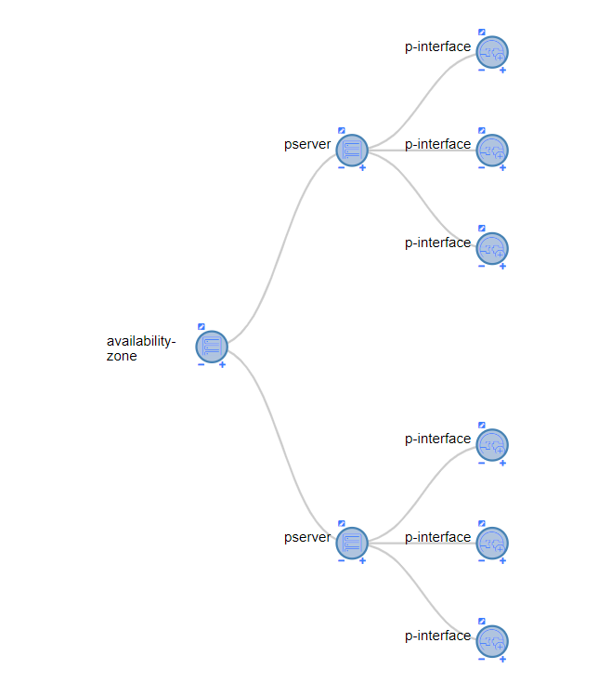
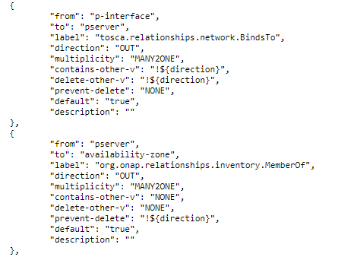
https://docs.onap.org/projects/onap-aai-aai-common/en/istanbul/platform/Getting%20Started/Edge_Rules.html#how-to-interpret-an-edge-rule
Core Components: Schema cont..
2. DbEdgeRules_v$.json – defines relationships between nodes
Multiplicity: One2One, One2Many, Many2One, Many2Many
One2One: On a node, there may be only one IN edge, and only one OUT edges.
One2Many: means on a node, there may be only one IN edge, and many OUT edges.
Many2One: means on a node, there may be many IN edge, and only one OUT edges.
Many2Many: On a node, there may be many IN edge, and many OUT edges.
In this example, It has multiplicity of MANY2ONE. pserver gets the IN edge, so it may have many edges from p-interfaces. The p-interface gets the OUT edge, so it may have only one edge to pserver.
Direction: OUT, IN
OUT: Point the edge out from the “from node” and IN to “to Node”.
IN: Point the edge in to “from node” and out from “to Node”.
In diagram, Edge is point out from p-interface and in to pserver
Containsother-v : is like isparent.
Delete-v : to denote if there is anything to be delete along with
Sample EdgeRule File
Note: “from” and “to” do not imply direction. Think of them as more like “NodeA” and “NodeB”.)
Notes:
https://wiki.onap.org/display/DW/AAI+Edge+Rule+Enumerator+Values

Slide 13
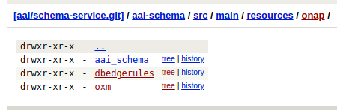
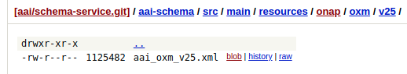
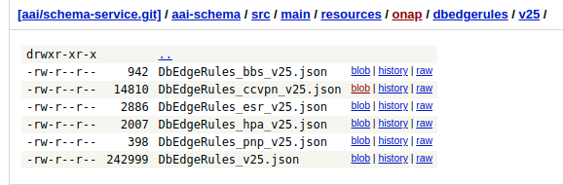
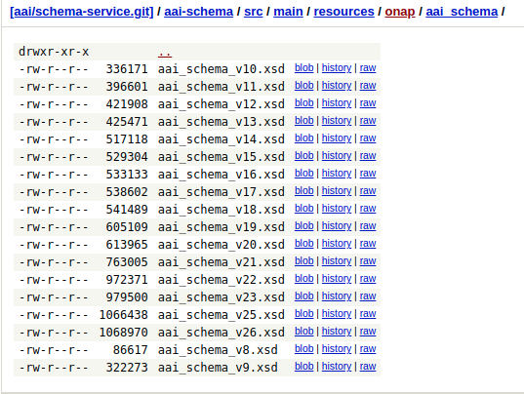
Core Components: Schema - GIT Location
https://gerrit.onap.org/r/gitweb?p=aai/schema-service.git;a=tree;f=aai-schema/src/main/resources/onap;h=13228b31b9b9395d6382a8f19bc10f88bad0b309;hb=refs/heads/master
Note: User needs to handwrite OXM and edgerule file, during build XSD is autogenerated.

Slide 14
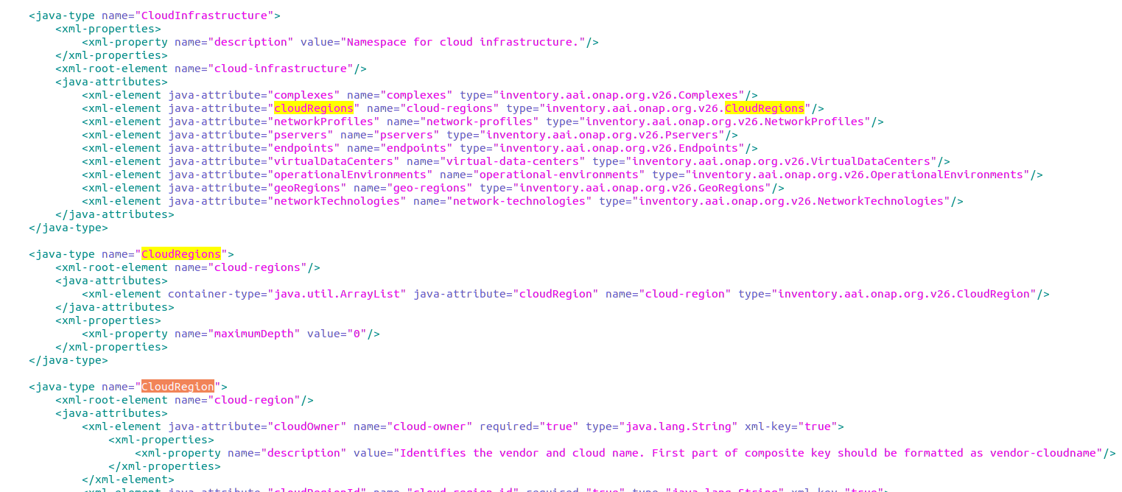
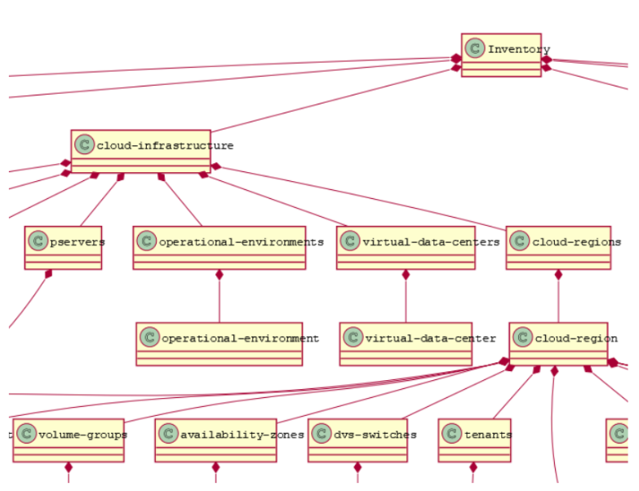
Core Components: Resource mS
1
AAI Resources Micro Service providing CRUD REST APIs for inventory resources.
Schema-driven APIs: Create Rest Endpoints for operate on resources, from OXM file which is obtained from shema service.
Example:
java-types defined in the OXM file define the REST endpoints - for example, the java-type “CloudRegion” in aai-common/aai-schema/src/main/resources/oxm/aai_oxm_v26.xml maps to /aai/v26/cloud-infrastructure/cloud-regions/cloud-region.
2
2
3
3
1
1
2
3
2
3

Slide 15
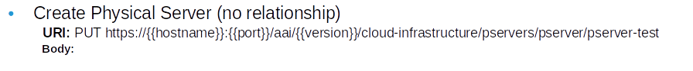
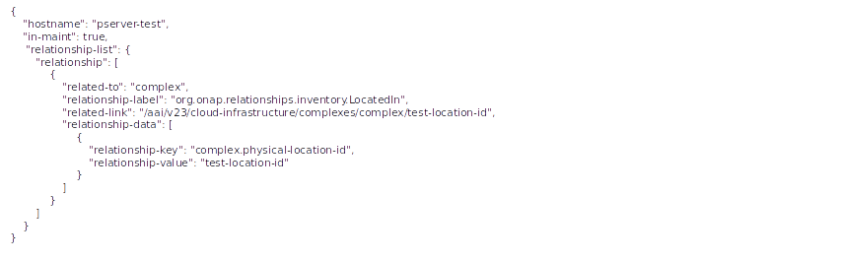
Core Components: Resource mS - Create Resource
Create Physical Server (w/relationship to complex)
URI: PUT https://{{hostname}}:{{port}}/aai/{{version}}/cloud-infrastructure/pservers/pserver/pserver-test
Body:

Slide 16
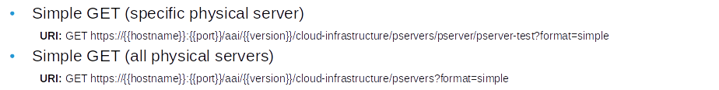
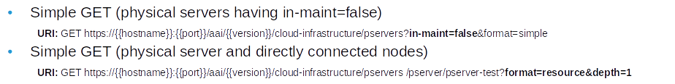
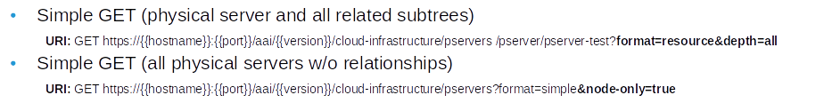
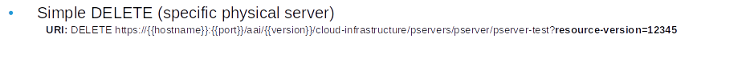
https://docs.onap.org/en/elalto/submodules/aai/aai-common.git/docs/AAI%20REST%20API%20Documentation/AAIRESTAPI.html#aai-resources-crud-apis
Core Components: Resource mS (GET/Delete Op.)
Resource APIs support multiple formats of output results, for different needs.
Simple: simplified format with node-type, graph vertex id, pathed url, object properties, and directly related objects in the graph are all returned.
depth: A depth query parameter to get result of that label of connected nodes.
node-only: query for nodes information without relationship.

Slide 17
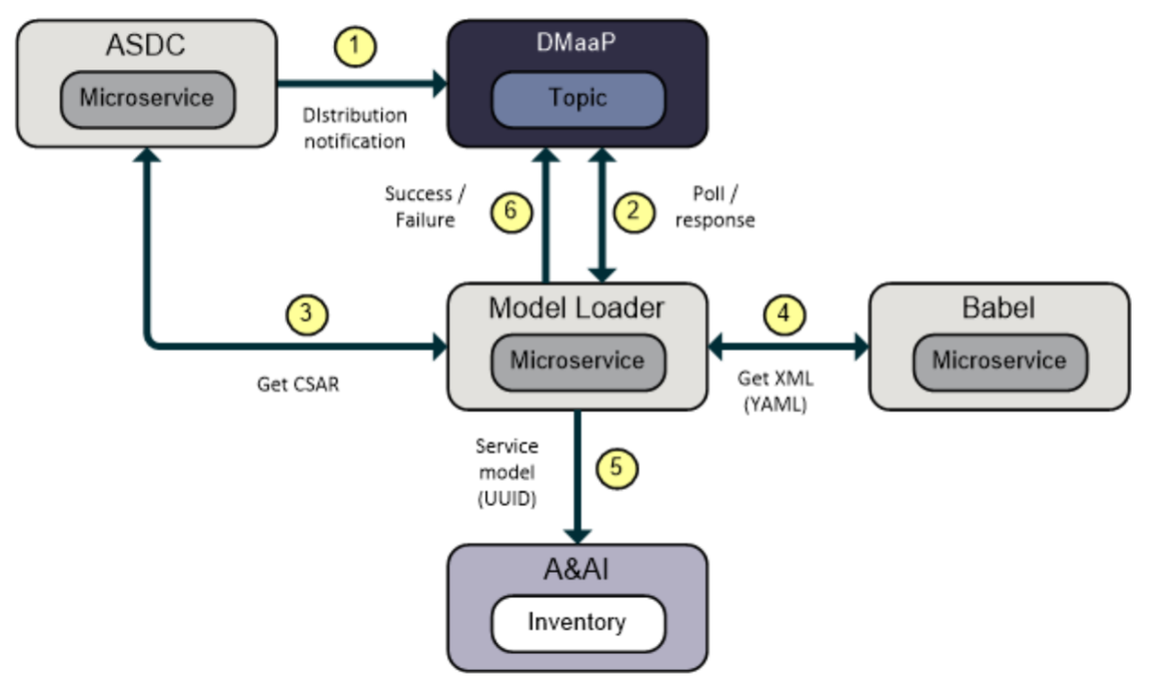
Core Component - Model Loader & Babel
Model Loader mS:
mS that facilitates the distribution and ingestion of new service and resource model from SDC to AAI
Uses Babel and Resources to load models into the A&AI graph database
A notification is posted on the distribution topic
The Model Loader polls the topic for new TOSCA CSAR distributions
The Model Loader GETs the new CSAR using the ASDC distribution client
The Model Loader POSTs the CSAR to the Babel service for transformation. The Babel service returns XML back to the Model Loader
The Model Loader GETs the model from A&AI Resources using its UUID. If the model already exists then model ingestion is skipped. Otherwise the model is ingested using a REST PUT to the A&AI Resoures mS
The Model Loader returns an event indicating the success/failure status of the model deployment
Babel mS:
mS that parses TOSCA YAML files extracted from a CSAR payload
Provides a secured endpoint accepting HTTP POST requests
Base64-encoded SDC CSAR data is POSTed to the Babel microservice in a JSON payload
The JSON body is validated, and the encoded CSAR is extracted
The CSAR content is transformed to XML files containing AAI Model Data that is returned to the requestor

Slide 18
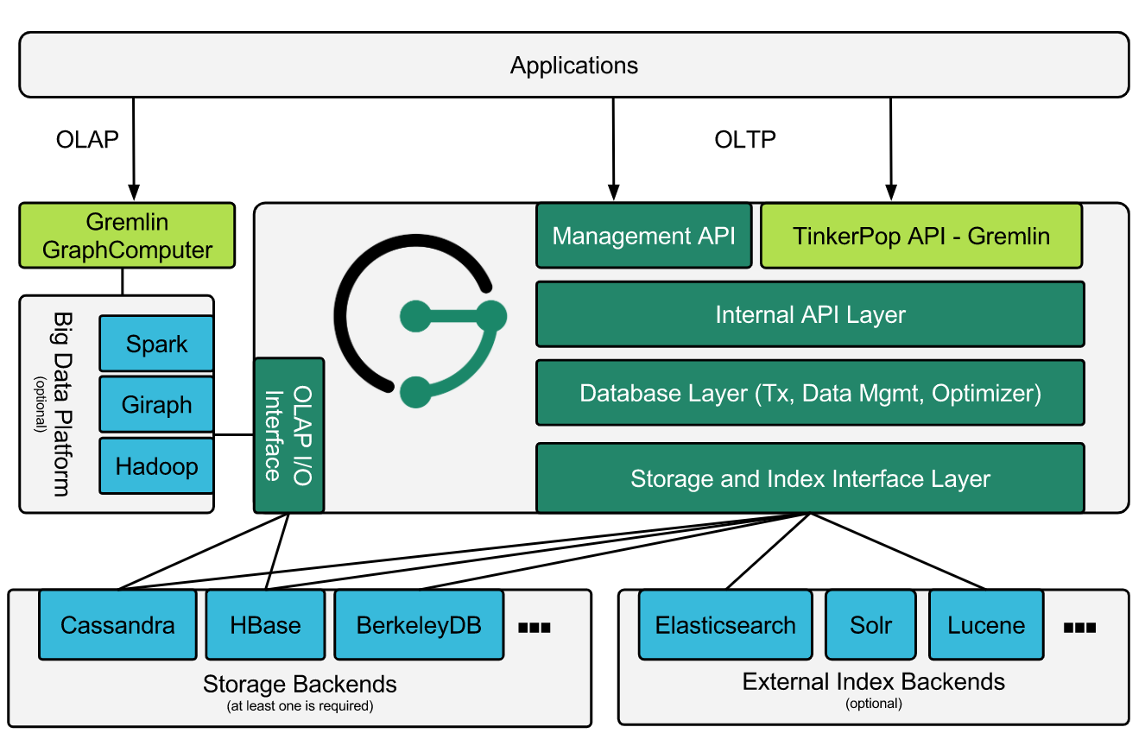
https://janusgraph.org/
https://tinkerpop.apache.org/docs/3.6.0/reference/
Core Component - Data Storage
Note: For Inventory Data storage, AAI usages open source Janus Graph DB.
JanusGraph: JanusGraph is a scalable graph database, optimized for storing and querying graphs, containing hundreds of billions of vertices and edges distributed across a multi-machine cluster.
JanusGraph is built upon several open source like plugable storage backend, Index backends, Apache TinkerPop etc.
Storage backends(Cassandra is used by AAI):
Apache Cassandra, Apache HBase, Google Cloud Bigtable, Oracle BerkeleyDB, Scylla
Index Backends for Fast & Efficient traversal(Elasticsearch is used by AAI):
Elasticsearch, Apache Solr, Apache Lucene
Apache Tinkerpop graph stack as API server and gremlin query language
Cassandra
Backend DB. scalable, distributed, NoSQL database
ElasticSearch for fast Indexing:
speed up and enable more complex queries
Apache TinkerPop
Apache TinkerPop is an open source Graph Computing Framework used by multiple graph DBs. It interacts with the Gremlin language commands to create, traverse, and manipulate graphs.
Gremlin
There are two parts to Gremlin: the language and the server.
Gremlin, the language, is a graph traversal language that are used to interact and query the graphs.
Gremlin, the server, is a specification for a server that processes local or remote Gremlin language queries. An implementation of it is part of Apache Tinkerpop.
Janus Graph

Slide 19
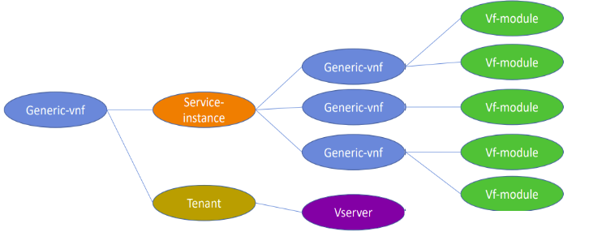
Core Component - Traversal
https://docs.onap.org/en/elalto/submodules/aai/aai-common.git/docs/AAI%20REST%20API%20Documentation/customQueries.html
https://docs.onap.org/projects/onap-aai-aai-common/en/stable/AAI%20REST%20API%20Documentation/AAIRESTAPI.html
AAI Traversal Micro Service providing REST APIs for traversal/search of inventory resources. It provides capabilities to do more advanced search for resources based on input queries than just GET API for specific resource and related nodes.
Traversal Example: A custom query that starts at a generic-vnf, follows the edge to the service-instance, then gets all connected vnfs and their vf-modules. It also return Tenet and Vservers
2 types of query APIs:
Custom Query - It allows clients to develop and deploy stored queries to make processing complex services. It requires development for updates if any to existing query
DSL - DSL is new feature delivered in Frankfurt that will allow users to specify ad-hoc queries that will make AAI more flexible and robust than previous versions. It required no development impact for new query.

Slide 20
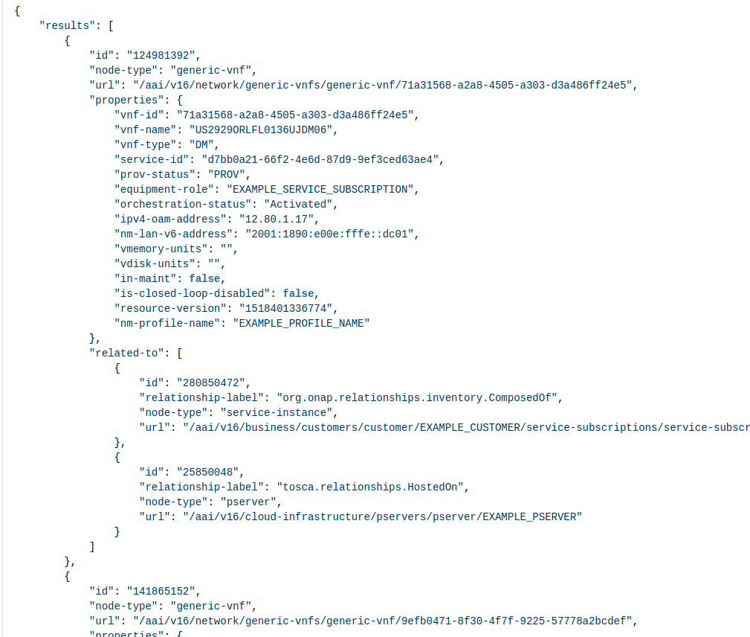
Core Component - Traversal APIs - Custom & DSL query
https://docs.onap.org/projects/onap-aai-aai-common/en/istanbul/AAI%20REST%20API%20Documentation/customQueries.html
https://wiki.onap.org/display/DW/genericVnfs-fromPserver
https://wiki.onap.org/display/DW/AAIService+Custom+Query+in+SDN-C
https://wiki.onap.org/pages/viewpage.action?pageId=64005527
Custom query example: To execute a custom query, a client will perform a PUT on the query API and include a payload indicating the starting node and the query to be run.
query genericVnfs-fromPserver allows a client to provide A&AI with a pserver hostname and retrieve the generic-vnfs related to it.
Input: pserver, Output: generic-vnfs
DSL query example:
To execute a DSL query, a client will perform a PUT on the dsl endpoint and include a payload that includes the dsl query to be run
Example:
Starting with a customer object, traverse through service-subscriptions and service-instances, and traverse any edges to connector objects. Store the connectors and any connected virtual data centers and their generic vnfs, and return the set.
{
"dsl" : " customer('global-customer-id','8310000058863-16102016-aai1539') > service-subscription > service-instance > connector* > virtual-data-center* > generic-vnf* "
}
Custom Query API: PUT /aai/v26/query?format=resource
API payload:
{
"start":["cloud-infrastructure/pservers?hostname={hostname}"],
"query":"query/genericVnfs-fromPserver?nfNamingCode={nf-naming-code}"
}
Output
Custom query used by SDN-C AAI Service:
Sample custome-query request
<save plugin="org.openecomp.sdnc.sli.aai.AAIService"
resource="custom-query"
key="format = 'resource'"
force="true"
local-only="false"
pfx="tmp.AnAI-data.vnf">
<parameter name="start[0]" value="`'network/generic-vnfs?vnf-name=' + $tmp.vnf-name`" />
<parameter name="start_length" value="1" />
<parameter name="query" value="query/complex-fromVnf" />
</save>
Notes:
Named queries: https://wiki.onap.org/display/DW/vnf+to+esr-system-info+Named+Query

Slide 21
AAI Installation
https://docs.onap.org/projects/onap-aai-aai-common/en/latest/platform/Getting%20Started/AAI_Developer_Environment_Setup.html
Development Environment Setup: https://docs.onap.org/projects/onap-aai-aai-common/en/latest/platform/Getting%20Started/AAI_Developer_Environment_Setup.html
Install single node janusgraph: This will start cassandra, elasticsearch and gremlin server(including janusgraph) process
Install haproxy
This will install HaProxy which act as gateway and listen on 8443.
Now All request can be made to 8443 and it will redirect to aai
Download AAI below services code: aai-common schema-service resources traversal graphadmin logging-service
Janus setup config to services: update config to resource, traversal and graphadmin in properties files
storage.backend=cassandra
storage.hostname=localhost
storage.cassandra.keyspace=onap
Build all above modules
Install the schema: Run graphadmin genteaster on the local instance which commit schema to db..
start Resource, traversal and graphadmin services
OOM based Setup: https://wiki.onap.org/pages/viewpage.action?pageId=35522241
Troubleshooting:
To verify that Janusgraph installed successfully, run below script which is part of janusgrah tar pkg.
./bin/janusgraph.sh status
The output should looks like this:
Gremlin-Server (org.apache.tinkerpop.gremlin.server.GremlinServer) is running with pid 9835
Elasticsearch (org.elasticsearch.bootstrap.Elasticsearch) is running with pid 9567
Cassandra (org.apache.cassandra.service.CassandraDaemon) is running with pid 9207
Swagger: https://wiki.onap.org/display/DW/AAI+REST+API+Documentation+-+Jakarta
Logs: check logs for schema is committed successfully in file graphadmin/logs/createschema/metrics.log
Notes:
https://docs.onap.org/projects/onap-aai-aai-common/en/latest/platform/Getting%20Started/AAI_Developer_Environment_Setup.html

Slide 22
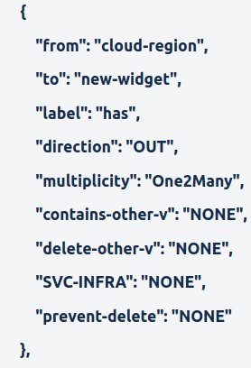
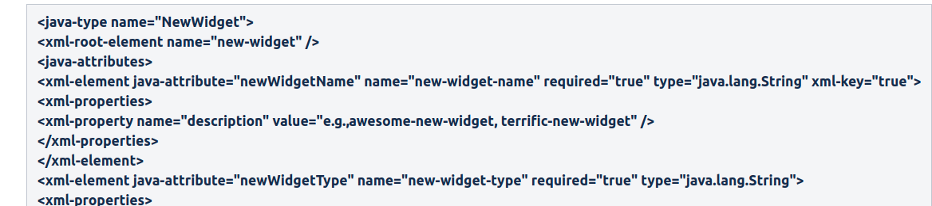
https://wiki.onap.org/display/DW/AAI+Tutorial-Making+and+Testing+a+Schema+Change+-+Dublin
Demo
DEMO setup: https://wiki.onap.org/display/DW/AAI+Tutorial-Making+and+Testing+a+Schema+Change+-+Dublin
CRUD Operations on new resource
Demo steps:
Update schema in schema service(Adding "newWidgets" to "Network" so the URI will be "aai/v16/network/new-widgets/new-widget/{new-widget-name}")
Add new Resource NewWidget in OXM file in below path:
schema-service/aai-schema/src/main/resources/onap/oxm/v16/aai_oxm_v16.xml
Add new Edge rule in DBEdgeRules file in below path:
schema-service/aai-schema/src/main/resources/onap/dbedgerules/v16/DbEdgeRules_v16.json
Rebuild schema, graphadmin, resource and traversal mS.
Run GenTester in the graphadmin repository
Start Resource, graphadmin and traversal mS.
GET/PUT op. on new-widget
Create cloud region with a relationship to the new-widget
GET again new-widget, it will show relationlist to cloud region
HAproxy
Update Schema for new resource and Edge
Schema mS
Resource mS
Graphadmin mS
Traversal mS
JanusGraph DB
(Cassandra, Elasticsearch,Gremlin server)
TroubleShoot:
If resource service getting below issue, then restart resource service again.
Postman:
https://wiki.onap.org/download/attachments/58230112/New-Widget%20Example.postman_collection.json?version=1&modificationDate=1550621736000&api=v2
Notes:
https://docs.onap.org/projects/onap-aai-aai-common/en/latest/platform/Getting%20Started/AAI_Developer_Environment_Setup.html

Slide 23
Schema driven Inventory

Slide 24
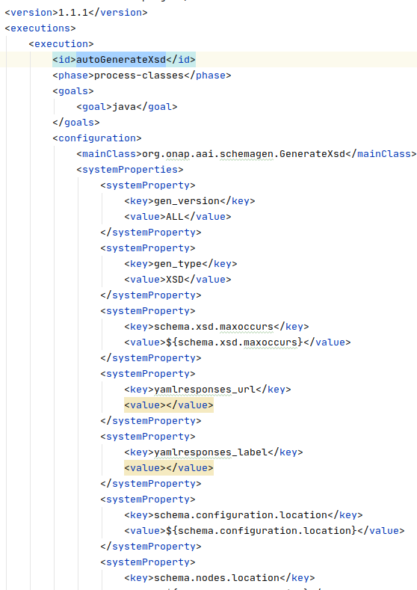
Xsd generation from OXM
Dynamic schema update :
In aai schema service, it generate xsd file from oxm.
At compile time, run GenrateXsd class to generate xsd file.
oxm file and output xsd file path is mentioned in POM.
File Location: schema-service---> aai-schema-gen ----> POM.xml
.Exec Maven Plugin
A plugin to allow execution of system and Java programs
Class to run: GenrateXsd
Notes:
https://www.mojohaus.org/exec-maven-plugin/

Slide 25
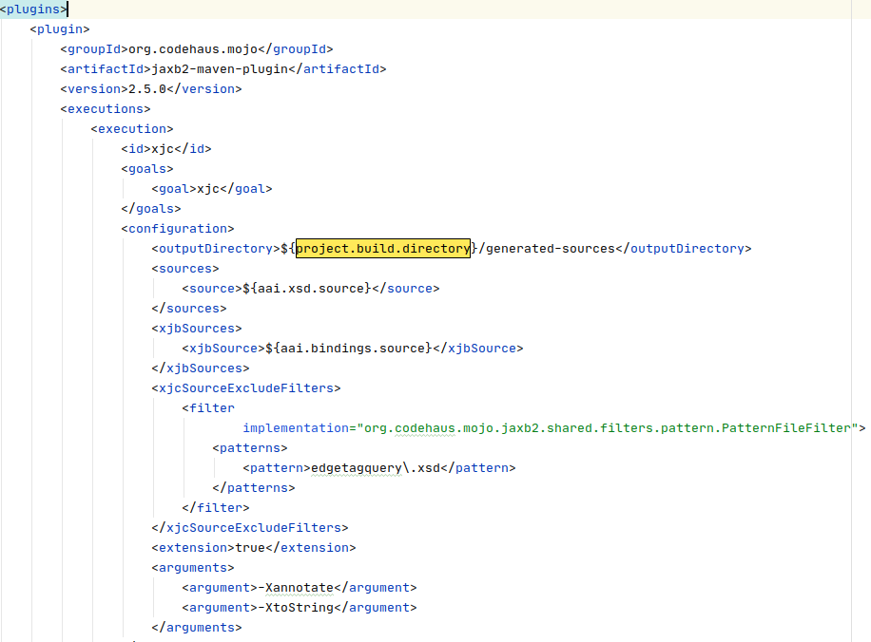
Java class generation from schema(xsd file) in AAI
https://www.mojohaus.org/jaxb2-maven-plugin/Documentation/v2.2/example_xjc_basic.html
In schema service, generate java class from xsd file.
It uses jaxb2-maven-plugin maven plugin to generate class from xsd files.
POM File Location: schema-service---> aai-schema ----> POM.xml
maven plugin: jaxb2-maven-plugin (org.codehaus.mojo)
goals : xjc ,
Config:
<outputDirectory>${project.build.directory}/generated-sources</outputDirectory>
<sources>
<source>${aai.xsd.source}</source>
</sources>
<xjbSources>
<xjbSource>${aai.bindings.source}</xjbSource>
</xjbSources>
xsd Source:
<properties>
<onap.nexus.url>https://nexus.onap.org</onap.nexus.url>
<!-- Start of Default ONAP Schema Properties -->
<aai.xsd.source>src/main/resources/onap/aai_schema</aai.xsd.source>
<aai.bindings.source>src/main/xjb/bindings-onap.xjb</aai.bindings.source>
<!-- End of Default ONAP Schema Properties -->
</properties>
Note: Usages of these java classes are not clear(it is not used by client OR resource service. maybe used by other aai mS)

Slide 26
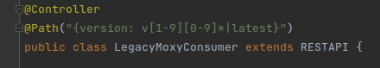
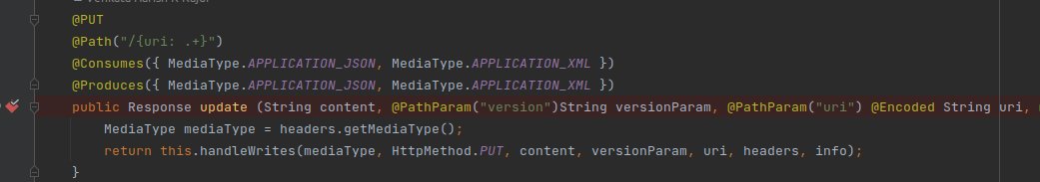
AAI Dynamic APIs and Entities(Resource mS)
LegacyMoxyConsumer.java
Dynamic APIs:
Restcontroller for handle CRUD operation on resource.
wildcard URLsupport for handle any resource by parsing the URL.
Using resource name from url, generate/query graph DB for vertex with resource name.
Dynamic Entities:
Dynamic entities class using DB schema from OXM file for each resource in oxm file.
request body(xml/json) for a resource is marshal/unmarshal to dynamic entities.
Usages EclipceLink JPA for Dynamic entities.
Graph DB Data Op:
Tinkerpop gremlin client libs to communicate with janus graph DB.
AAI internal code for handling DB request from rest request.
Based on URL, first get resource and create/query vertex
Then from dynamic entities class for this resource, get each properties and update in vertex peropties by using tinkerpop clint,

Slide 27
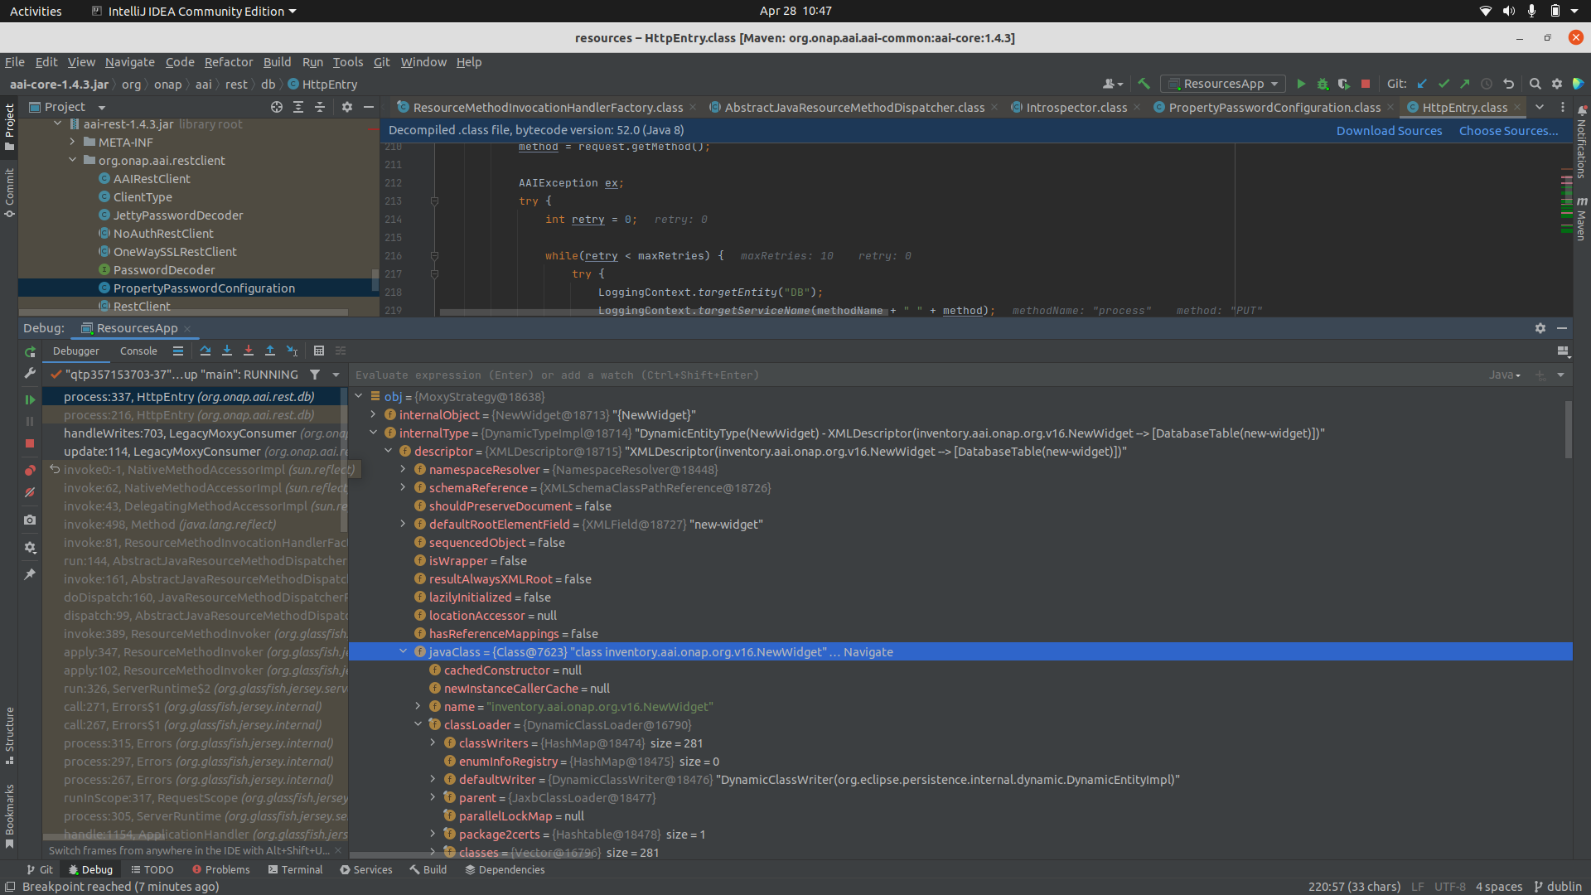
281 dynamic Entities Class based on OXM files
obj = request.getIntrospector();

Slide 28
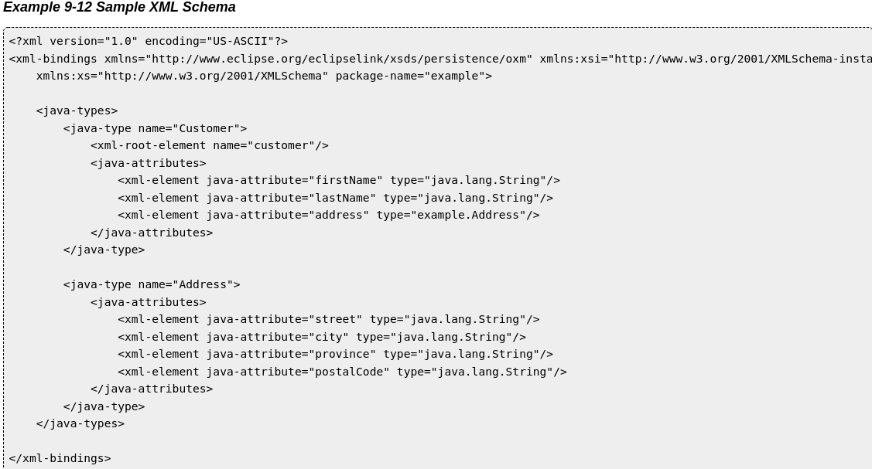
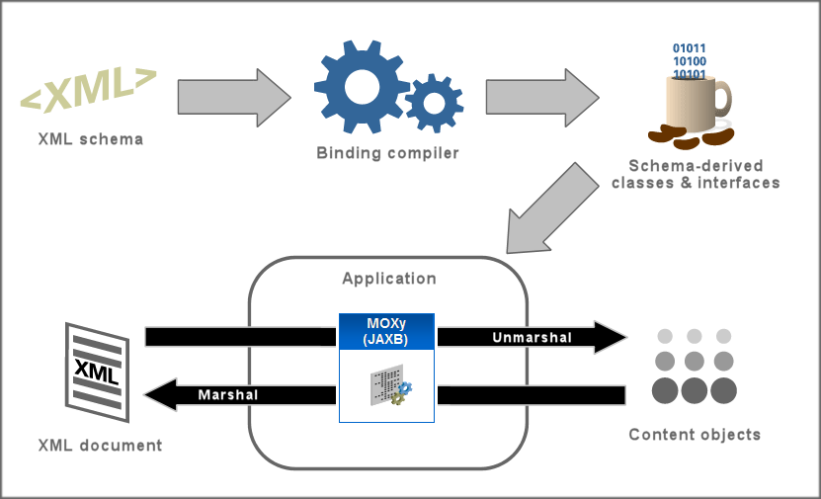
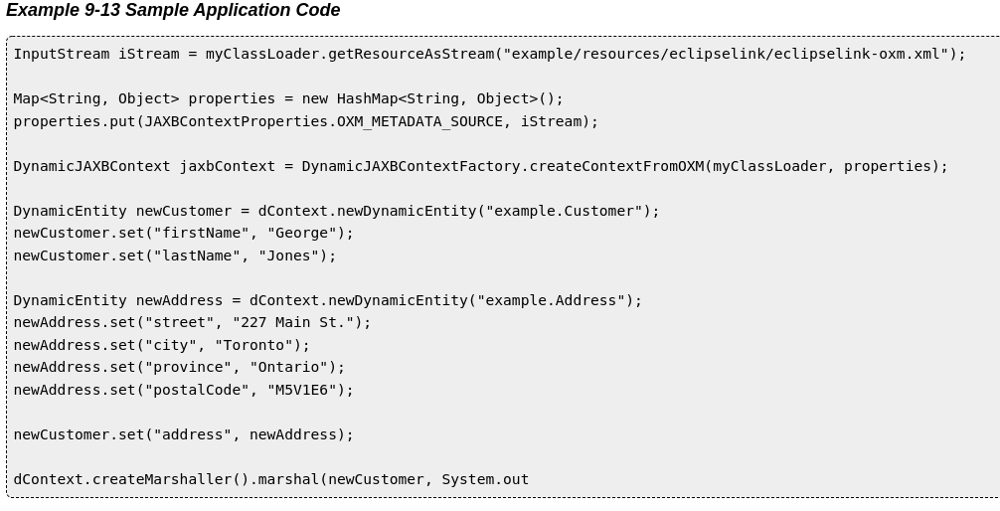
EclipseLink Moxy
https://www.eclipse.org/eclipselink/documentation/2.6/moxy/dynamic_jaxb004.htm
Eclise Moxy: generate dynamic entities class template from schema OXM file.
The MOXy component, supplied by EclipseLink, enables to efficiently bind Java classes to XML schemas.
When using EclipseLink MOXy as the JAXB provider, no metadata is required to convert your existing object model to XML.

Slide 29
Gremlin query language
What are the names of Gremlin's friends' friends?
1. Get the vertex with name "gremlin."
2. Traverse to the people that Gremlin knows.
3. Traverse to the people those people know.
4. Get those people's names.
g.V().has("name","gremlin"). out("knows"). out("knows"). values("name")
What are the names of the projects created by two friends?
1. ...there exists some "a" who knows "b".
2. ...there exists some "a" who created "c".
3. ...there exists some "b" who created "c".
4. ...there exists some "c" created by 2 people.
5. Get the name of all matching "c" projects.
g.V().match( as("a").out("knows").as("b"), as("a").out("created").as("c"), as("b").out("created").as("c"), as("c").in("created").count().is(2)). select("c").by("name")
Get a ranked list of relevant products for Gremlin to purchase.
1. Get the vertex with the name "gremlin."
2. Get the products Gremlin has purchased and save as "stash."
3. Who else bought those products and what else did they buy...
4. ...that Gremlin has not already purchased.
5. Group count the products and order by their relevance.
g.V().has("name","gremlin").
out("bought").aggregate("stash").
in("bought").out("bought").
where(not(within("stash"))). groupCount().order(local).by(values,desc)
Get the managers from Gremlin to the CEO in the hierarchy.
1. Get the vertex with the name "gremlin."
2. Traverse up the management chain...
3. ...until a person with the title of CEO is reached.
4. ...Get name of the managers in the path traversed.
g.V().has("name","gremlin").
repeat(in("manages")).
until(has("title","ceo")). path().by("name")
Get the distribution of titles amongst Gremlin's collaborators.
1. Get the vertex with the name "gremlin" and label it "a."
2. Get Gremlin's created projects and then who created them...
3. ...that are not Gremlin.
4. Group count those collaborators by their titles.
g.V().has("name","gremlin").as("a").
out("created").in("created").
where(neq("a")). groupCount().by("title")
Notes:
Gremlin example: https://tinkerpop.apache.org/gremlin.html

Slide 30
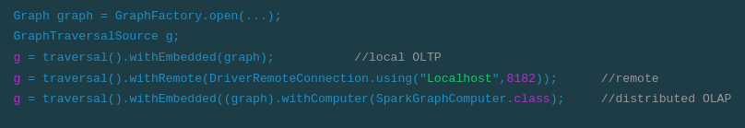
TinkerPOP gremlin client in Java
Gremlin java class:
public Class GremlinTinkerPopExample{
public void run(String name, String property){
Graph graph = GraphFactory.open(...);
GraphTraversalSource g = traversal().withEmbedded(graph);
double avg = g.V().has("name",name).
out("knows").out("created").
values(property).mean().next();
System.out.printIn("Average rating :" +avg);
}
}
Notes:
https://tinkerpop.apache.org/gremlin.html

Slide 31
AAI Client
Get xsd file from schema service and generate classes for each resource in schema file
Use:
maven plugin: jaxb2-maven-plugin (org.codehaus.mojo)
goals : xjc

Slide 32
THANKS

Slide 33
Resource mS : XML to DB entities
https://wiki.eclipse.org/EclipseLink/Examples/SDO/JPA
https://www.eclipse.org/eclipselink/api/2.3/org/eclipse/persistence/jaxb/dynamic/DynamicJAXBContextFactory.html
https://www.eclipse.org/eclipselink/documentation/2.6/moxy/dynamic_jaxb004.htm

Slide 34
Eclipse MOXy:
The MOXy component, supplied by EclipseLink, enables you to efficiently bind Java classes to XML schemas.
When using EclipseLink MOXy as the JAXB provider, no metadata is required to convert your existing object model to XML. You can supply metadata (using annotations or XML) if you want to fine-tune the XML representation.

Slide 35
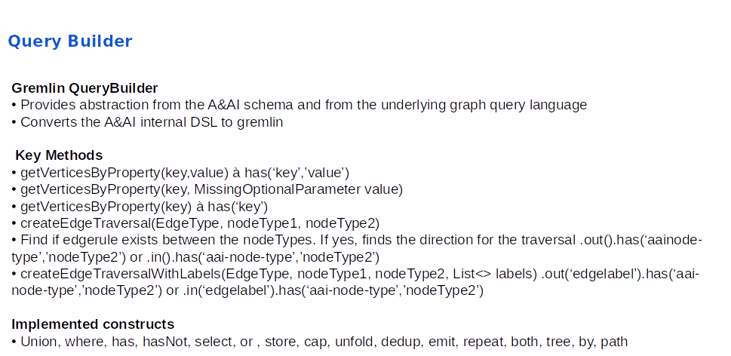

Slide 36
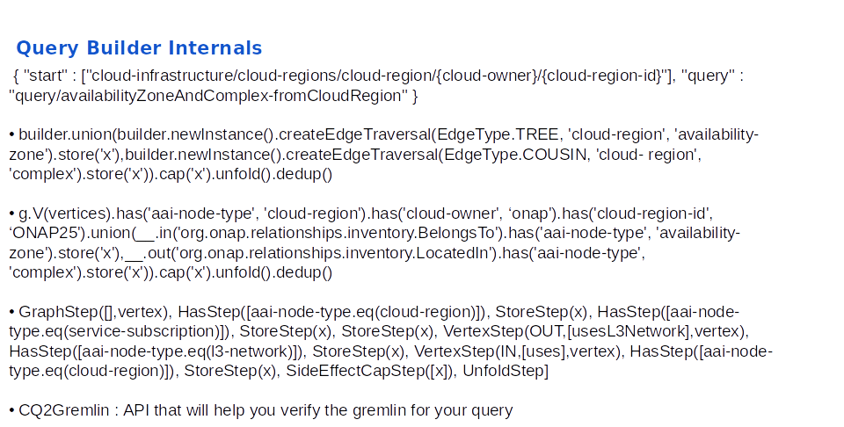

Slide 37
Resource mS Dynamic POJOs
https://www.eclipse.org/eclipselink/documentation/2.5/moxy/dynamic_jaxb003.htm

